Slide 1
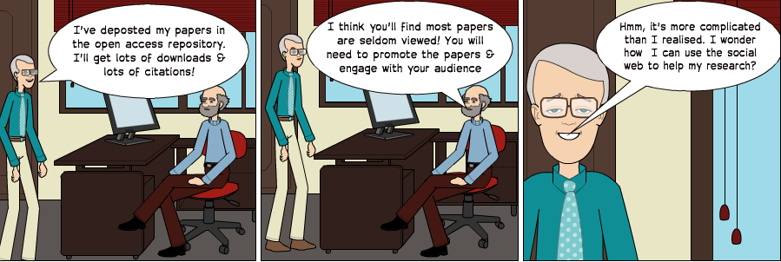
Open Practices for the Connected Researcher
Managing Your Professional Online Reputation
Workshop session facilitated by Brian Kelly at the IWMW 2013 event, University of Bath
Presentation by Brian Kelly, UKOLN on 25 October 2012 for an Open Access Week event at the University of Exeter

Slide 2
Managing Your Professional Online Reputation
Twitter: #iwmw13 #b3
http://iwmw.ukoln.ac.uk/iwmw2013/sessions/kelly/
Brian Kelly
UKOLN
University of Bath
Bath, UK
Acceptable Use Policy
Recording this talk, taking photos, having discussions using Twitter, etc. is encouraged - but try to keep distractions to others minimised.
Blog:
http://ukwebfocus.wordpress.com/
Twitter: @briankelly / @ukwebfocus
UKOLN is supported by:
Caveat: images may not be available with a CC licence. Where possible, links to source of images are provided to help you assess risks of reuse.
This work is licensed under a Create Commons Attribution 2.0 licence (but note caveat)

Slide 3
Idea from Cameron Neylon
You are free to:
copy, share, adapt, or re-mix;
photograph, film, or broadcast;
blog, live-blog, or post video of
this presentation provided that:
You attribute the work to its author and respect the rights and licences associated with its components.
Slide Concept by Cameron Neylon, who has waived all copyright and related or neighbouring rights. This slide only CCZero.
Social Media Icons adapted with permission from originals by Christopher Ross. Original images are available under GPL at:
http://www.thisismyurl.com/free-downloads/15-free-speech-bubble-icons-for-popular-websites
3

Slide 4
About This Session
Introduction
Abstract:
The growth of importance of the Social Web is providing new opportunities for those with skills and expertise in the use of Web-based tools. Not only can services such as LinkedIn and Twitter be used to enhance networking and dissemination activities carried out in institutional Web teams, knowledge of the tools and use of the tools is likely to be of interest to others within the institution, including staff in other support services (such as the Library and IT services), academic staff, researchers and students.
This session will explore ways in which Social Web services can be used to enhance one's professional profile, tools for monitoring their effectiveness and best practices for using the tools.

Slide 5
Draft Timetable
Introduction
Draft timetable (subject to change)
Time | Topic | Note
16.00-16.10 | Introduction
16.10-16.20 | About you & your interests
16.20-16.30 | Lightweight thoughts on the theory
16.30-16.45 | Sharing experiences
16.45-17.00 | Monitoring and managing use
17.00-17.15 | What else?
17.15-17.30 | Action plans

Slide 6
About Me
Introduction
Brian Kelly:
UK Web Focus: national advisory post to UK HEIs
Long-standing Web evangelist (since 1993)
Based at UKOLN at the University of Bath
Prolific blogger (1,100+ posts since Nov 2006)
User of various devices to support professional (and social) activities
Prolific speaker (~400 talks from 1996-2012)
Author of peer-reviewed papers on misc Web topics
Why I proposed this session:
I feel the social Web has much to offer in HE
People with Web skills are well-positioned to exploit interest in social Web & digital profile management

Slide 7
Why Are You Here?
About You
Some questions:
Why did you choose to attend this session?
What do you hope to gain from the session?
Are there any particular tools or services you’d like to hear about?
Do you have any tips or success stories to share? (Feel free to contribute during session)

Slide 8
My Professional Online Reputation
Purpose(s) of social web tools:
To maximise opportunities:
To discuss and engage in order to (a) refine thoughts and ideas and learn from discussions
Dissemination to maximise ROI & provide evidence
For future collaboration
Tools:
Blog, Twitter & LinkedIn (Facebook to lesser extent)
Researcher profiles (e.g. Academia.edu & ResearchGate)
Now little use of mailing lists
Particular challenges:
No host institution after 31 July!
Importance of Cloud & need to migrate from institution
Opportunities:
Consultancy; training; jobs, …

Slide 9
Group Exercise
About You
In small groups:
Describe why you use social media to support professional activities
The tools and services you use
Any particular personal opportunities and challenges

Slide 10
A Personal Audit
Type | Examples | Professional use
Social networks | Facebook | Keeping in touch; dissemination of blog posts
Resource sharing | Delicious; Slideshare | Sharing of interests & resources
Media sharing | YouTube; Flickr | Sharing talks & slides
Research profiles | Academia.edu; ResearchGate | Raising research profile & access to papers
CVs | LinkedIn | CVs; testimonials; …
Software | -
Knowledge sharing | Wikipedia; (Quora) | Sharing expertise
Geo-location | Facebook; FourSquare | “I was here”; “Anyone else around?”
Comms | Twitter; | Keeping in touch; developing links; sharing ; …
???
???
What type of social media tools do we use?
Suggest examples
Suggest uses
Suggest examples
Suggest uses
Suggest examples
Suggest uses
Suggest examples
Suggest uses
Suggest examples
Suggest uses
Suggest examples
Suggest uses
Suggest examples
Suggest uses
Suggest examples
Suggest uses
Suggest examples
Suggest uses

Slide 11
About Nodes and Connections
The Evidence

Slide 12
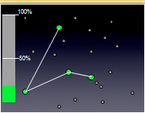
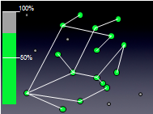
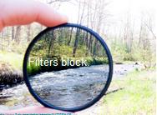
“It’s About Nodes and Connections”
Theory
Cameron Neylon keynote at OR 2012: “Networks qualitatively change our capacity”
With only 20% of a community connected only limited interaction can take place
This increases drastically as numbers of connected nodes grows
Examples:
Phone networks (no use with only 1 user!)
Tweeting at events
Galaxy Zoo
“Filters block. Filters cause friction”
Need for client-side, not supply-side filters.

Slide 13
SEO (Search Engine Optimisation)
Web sites
Google (Bing, DuckDuckGo, …)
Real world
Databases (e.g. IRs)
Summary of key approaches:
Apply various techniques to Web resources to make resources easier to find in Google, …
Resources may include organisational Web suites, third party Web sites, databases, …
Resources may also include real world objects and ideas (e.g. your research ideas, …)
Based on understanding of importance of Google to end users
Directories

Slide 14
Beyond SEO, SMO
Web sites
Social Services (Facebook, Slideshare, Twitter, …)
Real world
Databases (e.g. IRs)
Summary of key approaches:
Make use of social networking services which people may use of discuss your services
Services may include Facebook, LinkedIn, Slideshare, Twitter, …
No need to touch your Web sites (therefore useful if you can’t!)
Based on understanding of popularity of SNs and people’s interests in chatting and sharing
Directories

Slide 15
About Personality Characteristics
The Evidence

Slide 16
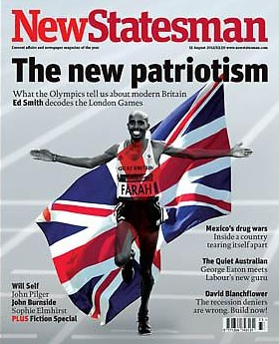
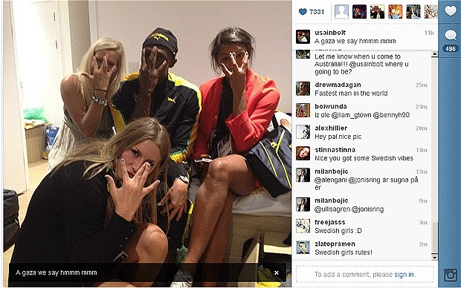
Are you a Roundhead or a Cavalier?
Are you a Roundhead or a Cavalier?
“In the century, Britain was devastated by a civil war that divided the nation into two tribes – the Roundheads and the Cavaliers. The Cavaliers represent a Britain of panache, pleasure and individuality. They are confronted by the Roundheads, who stand for modesty, discipline, equality and state intervention.”
X
Who is most like you?
Mo Farrah for winning the 5,000 and 10,000m?
Usain Bolt for partying with Swedish handball team after winning 100m, & before 200m & relay?

Slide 17
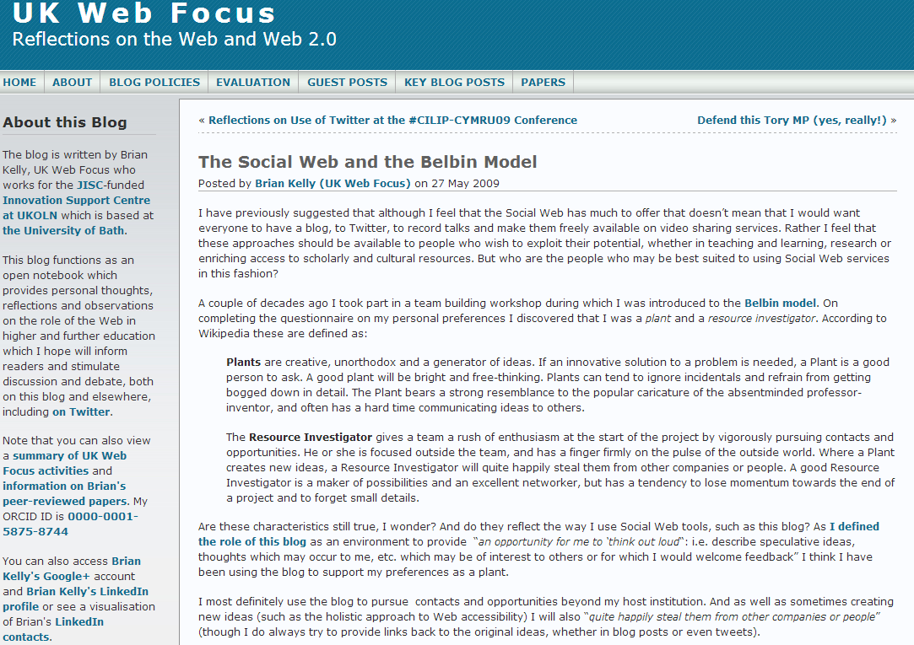
Personality Types
Do different personality type tend to use social networks?
“There have also been references to Myers-Briggs Type Indicator (MBTI) profiles and the prevalence of different types in using social networking. Generally speaking you might imagine the archetypical twitterer/blogger to be an ENFP (extrovert, envisioning, feeling, perceptual) sort of person. Me, I’m an ENTJ and proud of it.” DIH

Slide 18
The Three Key Stages
The Evidence

Slide 19
The Three Key Stages
Three key stages:
Own a digital identity
Audit / monitor your professional identity
Manage your professional identity

Slide 20
Owning a Digital Identify
Issues related to claiming a digital identity:
What does it do?
What can it do for me?
What are the resource implications in claiming and managing it?
What are the personal issues (including risks) relating to using it?
What will my boss; my peers; my organisation think?
…
This session assumes you have chosen to create digital identities and wish to manage them

Slide 21
Monitoring Your Digital Identity
Based on the services you use mentioned previously what approaches and tools do you use for:
Monitoring use of the services?
Helping to identify best practices?
Ensuring that the service provides a +ve ROI?
Monitoring possible misuse of the service?

Slide 22
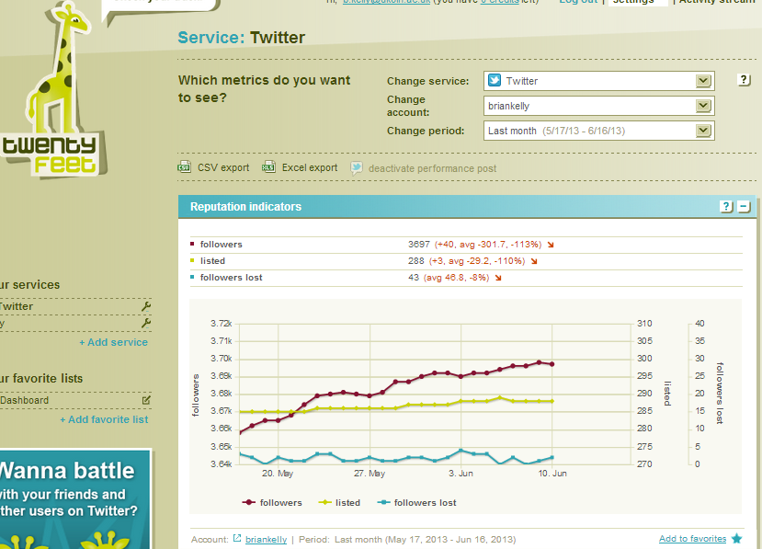
Twitter Metrics
Twentyfeet.com
Free service:
Gives you a dashboard
Costs you:
A weekly tweet: “My week on twitter: 64 retweets received, 1 new listings, 22 new followers, 119 mentions. Via: http://20ft.net/p ”
Licensed version provides (a) additional metrics (> one month); (b) >1 service (Twitter; bit.ly; …); (c) no ads

Slide 23
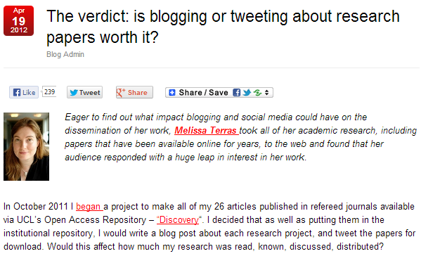
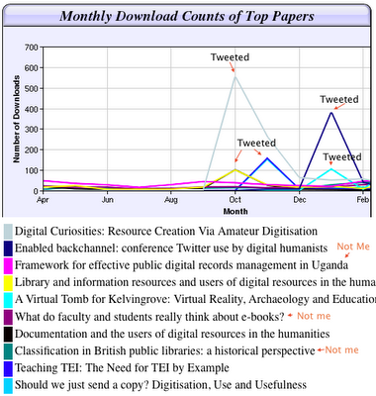
Evidence For Researchers
Blog post by Melissa Terras, 19 April 2012
The findings

Slide 24
What Did You Do?
The Evidence

Slide 25
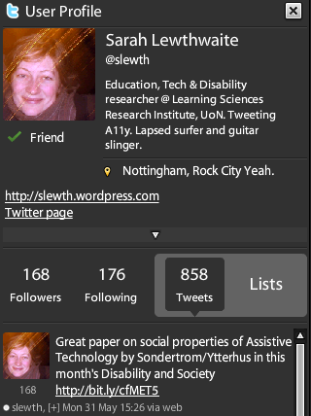
Developing New Connections
Developing New Connections
Tweet sent asking for researchers to complete survey on use of Web 2.0 in research
Response from @slewth
Who is she?
Twitter bio: disability researcher
Link in bio to her blog
Blog gives insights which complement my research
Follow @slewth and have Twitter chat
Follow-up
Shall we write a paper?
Paper written
Paper accepted
Paper wins prize for best paper ☺
See blog posts on “It Started With A Tweet”
and “Winner of John M Slatin Award at W4A 2010”

Slide 26
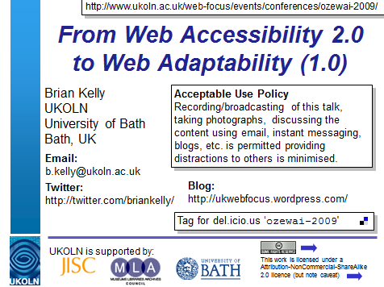
Event Amplification
‘Amplified event’: networked technologies at events to maximise (‘amplify’) ideas mentioned and subsequent discussions, including discussions between event attendees and remote participants.
Talks designed for ease-of-engagement
Slides on Slideshare & easily found
Twitter ID on Title slides
OzeWAI 2009 Conference
Invited keynote talk given in Melbourne, Jan 2009
Tweets received after talk: “@briankelly enjoyed your presentation this morning about a holistic approach to accessibility #ozewai” & “@briankelly Fantastic talk this morning, I will come up and say hi at lunch ;)”
We spoke, and they agreed to contribute to a paper. Paper published 6 months later ☺

Slide 27
Being Pro-active: An Implementation Plan
The Evidence

Slide 28
W4A 2012 Paper
Case study:
Paper on “A challenge to web accessibility metrics and guidelines: putting people and processes first” given at W4A 2012 conference in Lyon in Apr 2012
Four co-authors agreed:
To collaborate in raising awareness of paper and presentation of the paper
How:
Writing blog posts on or just before conference
Participate on conference Twitter hashtag (e.g. responding to comments while speaker is presenting)
Benefits:
Reaching out to a wider audience based on our 4 professional networks

Slide 29
Preparation
We:
Uploaded paper to repository so URL was known
Provided a link to the paper in speaker’s slides
Uploaded holding slide to Slideshare so URL was known (slides were finalised shortly before talk)
We could then:
Prepare blog posts in advance
Create short URLs in advance
Examples of approaches to follow

Slide 30
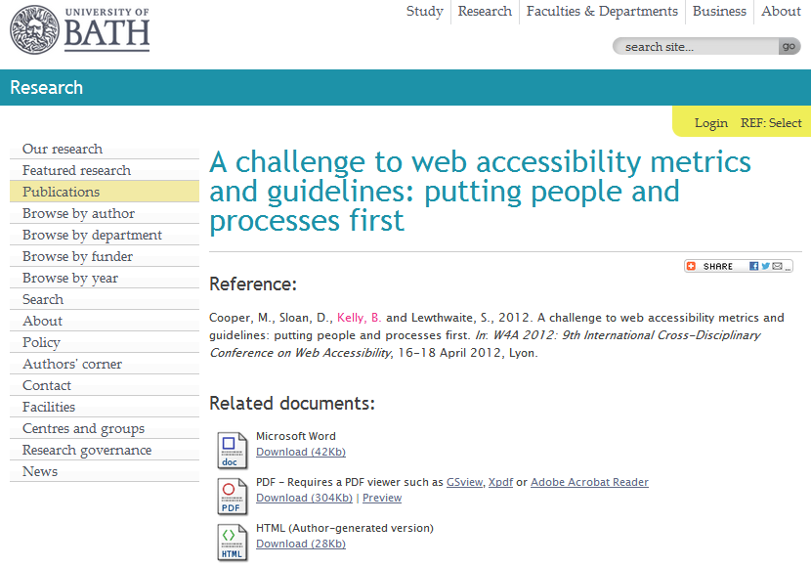
Opus Repository
Paper uploaded to Opus repository
Note lack of social features for repository: no discussions, metrics for sharing or ability to embed content
http://opus.bath.ac.uk/29190/

Slide 31
Slideshare
Note:
Sharing icons
Discussion (not shown)
Related content
Metrics
Embedability (not shown)
Metadata provided to give context to slides

Slide 32
Final slide provides (active) links to related work

Slide 33
Capture Statistics
On 18 Apr 12:
1,391 views on Slideshare
Other slides had 3 and 311 views
By 12 Jun 13:
9,080 views on Slideshare
“Lies, damned lies & statistics” – but my third most downloaded paper in 2012

Slide 34
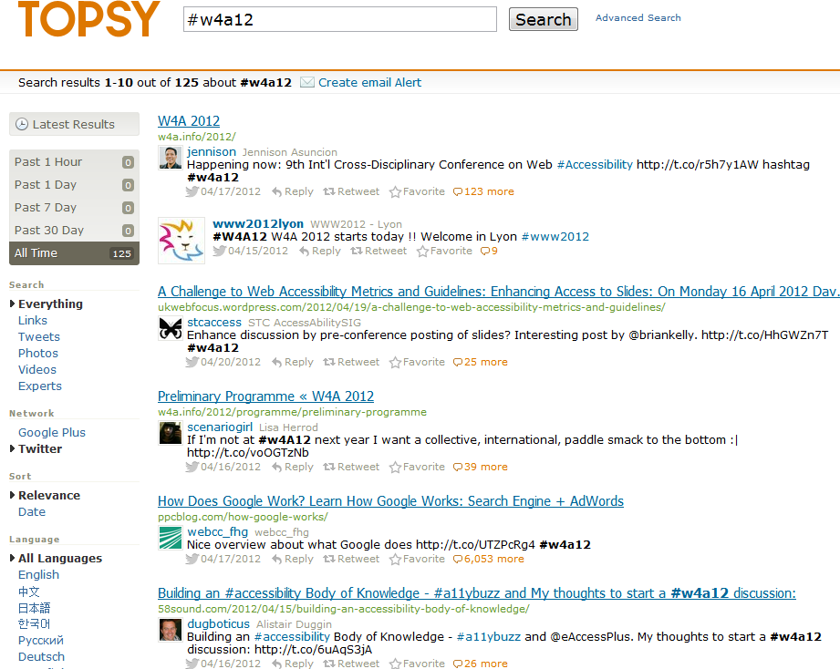
Topsy and Event Hashtag
Buzz around event hashtag captured by Topsy

Slide 35
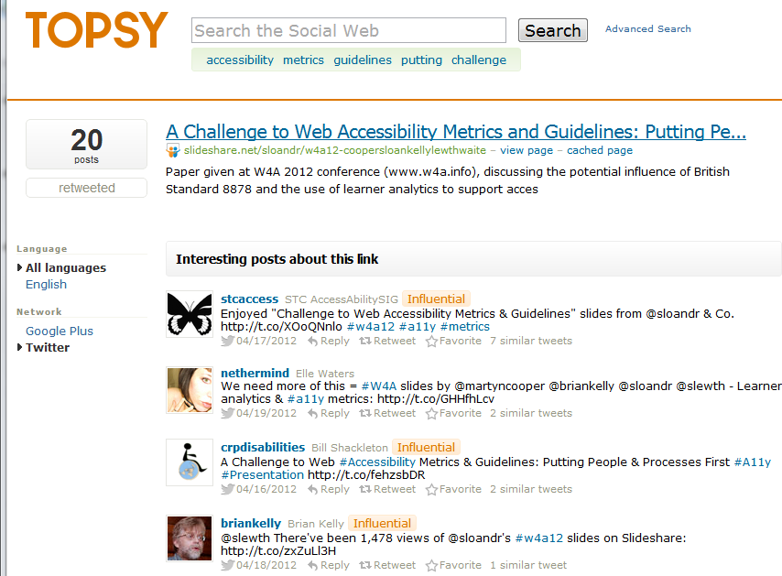
Topsy & Discussion About Slides
Topsy recorded discussions about slides
Twitter names suggest accessibility interests

Slide 36
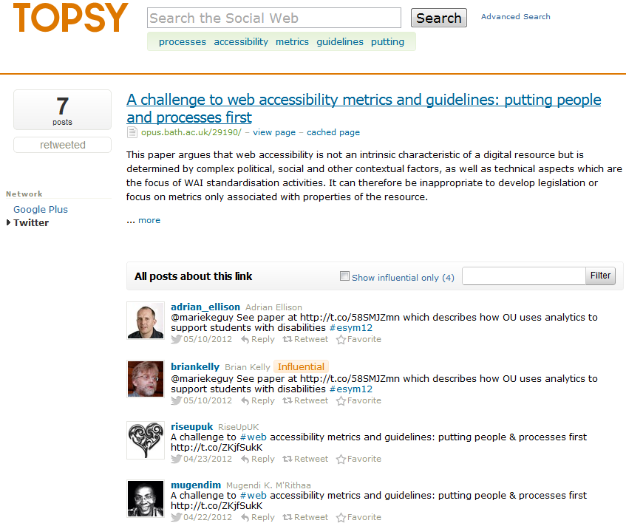
Topsy & Discussion About Paper
Topsy recorded discussions about paper
Note tweets about event (25) and slides (20) more popular than paper (7)

Slide 37
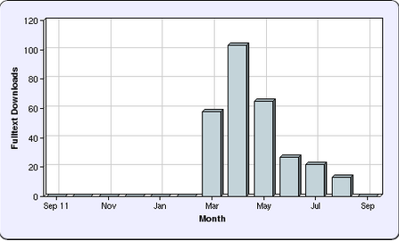
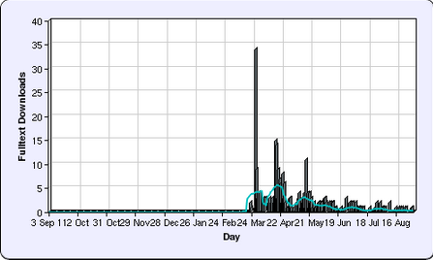
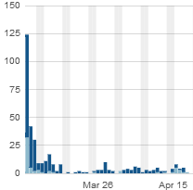
Repository Statistics
Opus repository stats:
Views began in March (before conference).
Largest downloads took place on 7 March, day blog post published (about collaborative tools for writing paper)

Slide 38
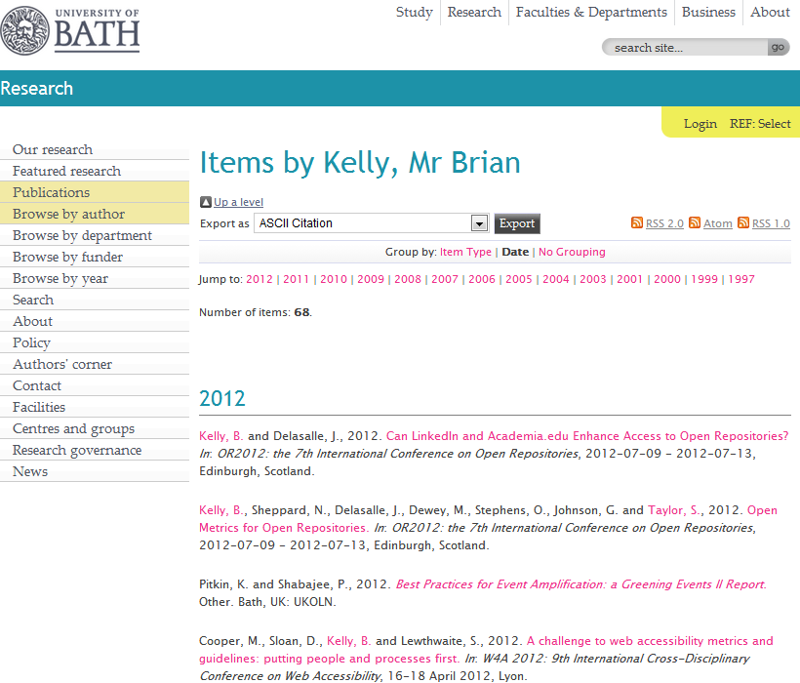
The IR
Your papers may be hosted on your institutional repository – but you need ‘link love’

Slide 39
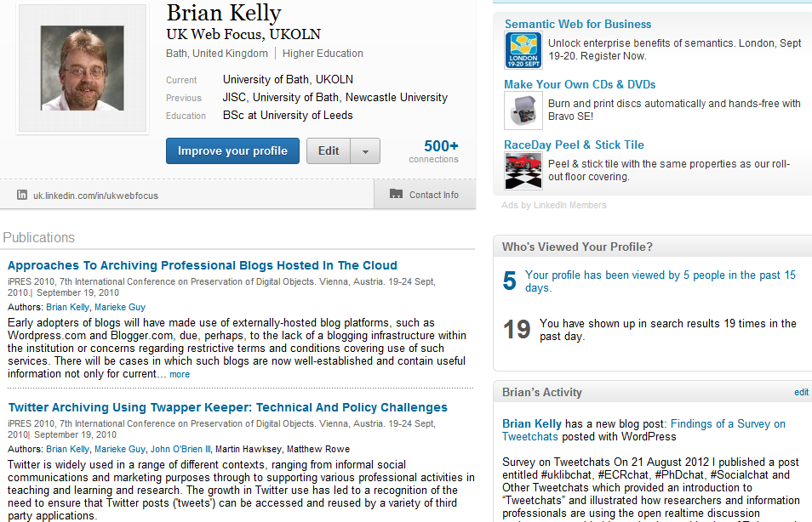
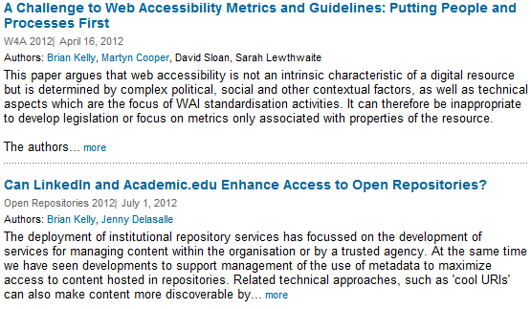
LinkedIn
LinkedIn is popular, so links from LinkedIn may be highly ranked
Therefore motivation to include links to papers
Links to paper added to
LinkedIn
Academia.edu
My pages on UKOLN Web site and blog
…

Slide 40
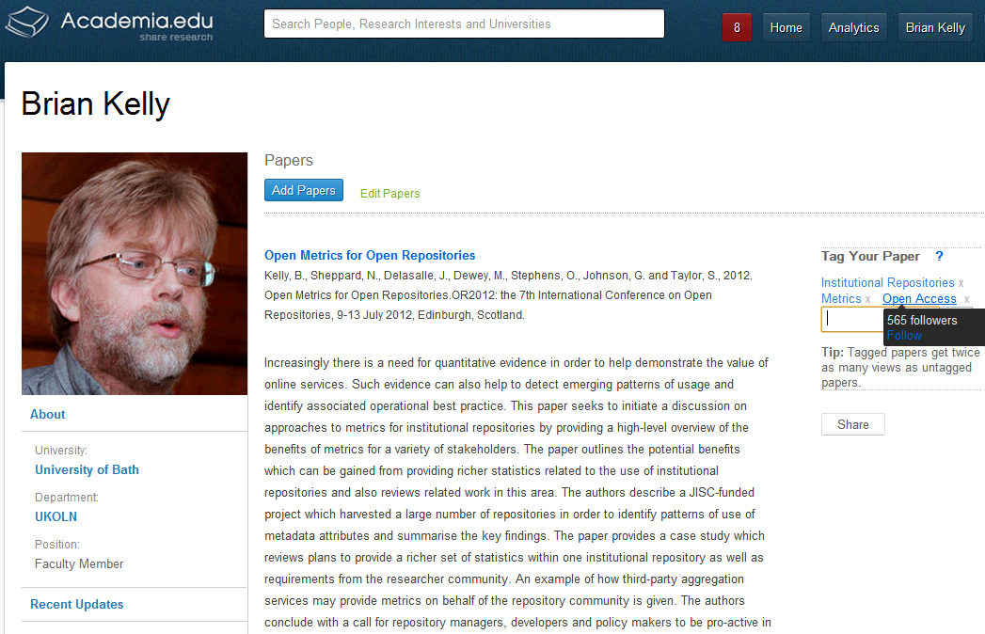
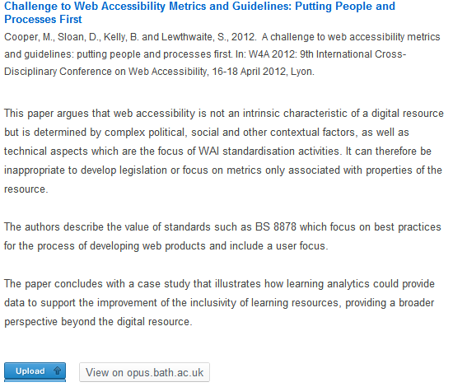
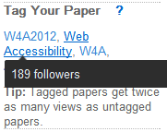
Academia.edu
Academia.edu
Academia.edu users may find my papers here and LinkedIn users in LinkedIn. Why would I make it difficult for them?
Note:
Links to papers in IR (not uploaded)
Importance of tags

Slide 41
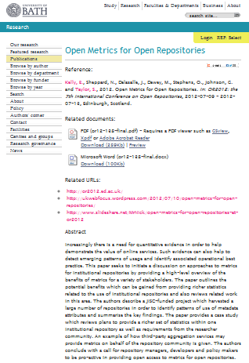
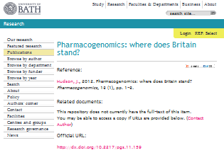
Importance of Google
Context:
Between 50-80% of traffic to IRs are from Google (may be higher if direct links to PDFs not recorded by Google Analytics)
What provides ‘Google juice’:
On-page SEO techniques (structure, writing style, …)
Links to pages, especially from highly-ranking sites
What’s different about IRs?
Same page structure
Therefore importance of links to repository

Slide 42
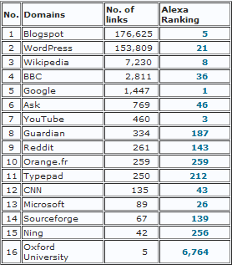
What Delivers Google Juice?
Survey of SEO ranking of 24 Russell Group IRs carried out in Aug 2012.
Findings:
Google, YouTube, Blogspot, Wikipedia and Microsoft are highest ranking domains with links to IRs
Blogspot.com & WordPress.com have significantly larger number of links to IRs
Blogspot.com
Wordpress.com
Links from institutional domain (e.g. locally-hosted blogs) provide little Google juice!

Slide 43
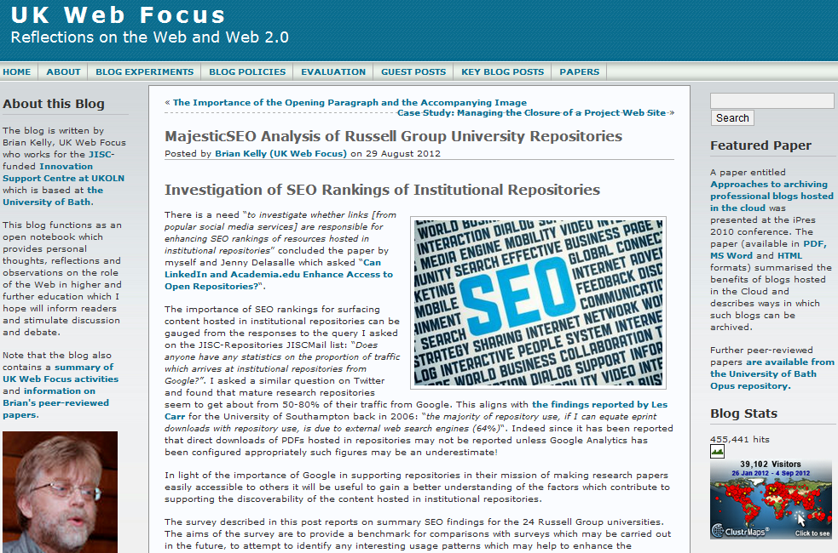
UK Web Focus has links to all papers
UK Web Focus has timely blog posts about papers
UK Web Focus blog has a rotating Featured Paper link

Slide 44
Barriers
The Evidence

Slide 45
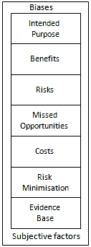
But …
But what about:
Legal, ethical & privacy concerns
My boss doesn’t approve
My institution doesn’t approve
It doesn’t work in my discipline
It doesn’t work for me
Risks and opportunities framework:
It’s not about ‘social media’ it’s about ‘social media for a particular purpose’
Be clear of potential benefits & associated risks
Remember the risks of not doing things
There will be costs (but may be small)
Adopt risk minimisation strategies
Base decisions on evidence
Be aware of biases and subjective factors

Slide 46
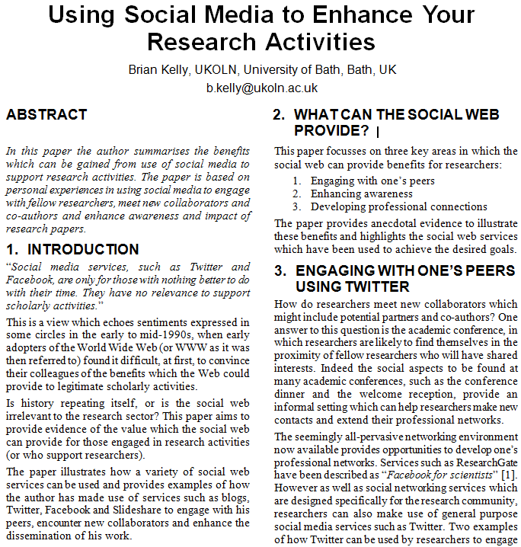
Paper
Accompanying paper available on:
ResearchGate
Academia.edu
Opus, University of Bath IR
Share with your friends and provide real-time peer-reviewing: http://bit.ly/sra13-kelly

Slide 47
Health Warning!
Suggestions given can help to enhance the visibility of one’s research.
Highly visible and popular research is not necessarily an indication of quality!

Slide 48
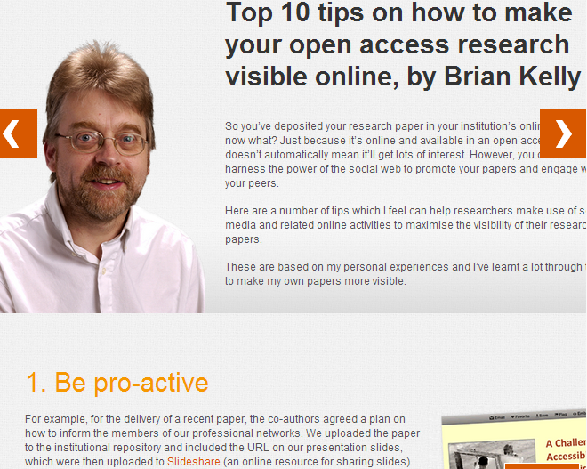
Top Ten Tips
Be pro-active
Monitor what works for you
Don’t forget the links
Don’t forget the Google juice
Develop your network
Encourage feedback and discussion
Understand your network
Know your limits
Seek improvements
Participate
See Top 10 tips on how to make your open access research visible online, JISC Inform, 35, Winter 2012

Slide 49
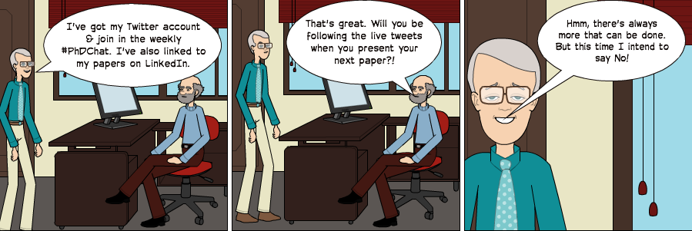
Any Questions?
Cartoon

