Slide 1
“LibrARy”: adventures with Augmented Reality

Slide 2
AR:
An ‘app’ which adds a layer to what you see when looking through your phone or tablet at an object, a poster or perhaps even a building.
Notes:
What is AR? – simple idea – do you all know what it is???
Like QR…
Very new, inexpensive,
Straightforward – doesn’t require programming experience
Runs on higher spec phones/tablets incl. Android

Slide 3
Enthusiasts:
Archives
E-learning
Library
Public Engagement
Students Union
Notes:
Engagement is key. It gives us:
- credibility (students)
- collaboration (ideas & priorities)
- competition (avoided)

Slide 4
Experiments:
identify a range of small scale projects
use the technology and explore options
publicise widely and share
Notes:
What did we want to do?
Try it out – see what works and what doesn’t
Share experiences and expertise

Slide 5
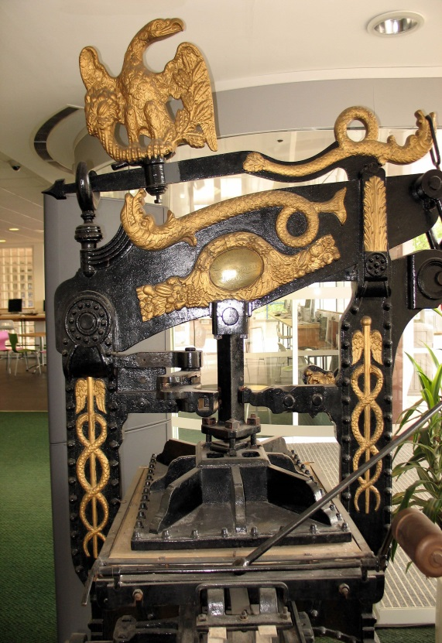
Projects:
augmenting an image
augmenting an object
augmenting the campus
Notes:
We experimented with 3 different things:
Images of research (Dr Mark Greco’s 3D image of beehive) – (John T did his too…): adds an extra dimension
(best image & preview night): video
Real-time availability of computers and printers for student use: floorplans and feeds
Library: link to the availability
Printing press: link to the collection
Linking to ‘hidden’ information: associated collections, youtube video etc – plan to use a twitter #feed to collect views and Qs as well

Slide 6
How did we do it?
Considered our options
Talked to others: education & commercial
Took a ‘pragmatic’ approach
Notes:
Different apps – Janio, Layar, aurasma
Went to Manchester to Mimas (Matt Rameriz)
Talked to contacts in the city
Money, time, impact: ‘lights, camera, ACTION’…
Quick and easy links – quite ‘flat’ as not designed for this, but we can do better and make it more exciting in time (learning, e.g. clips short – marketing can help…)
Consider using ‘pro’ version (more control over our image and easier to link to our channels as embodied in the app.)

Slide 7
Spreading the word:
how to do it
go.bath.ac.uk/iraura13
how to look good
(Marketing)
help & sharing
(E-learning)
Notes:
Out and about at meetings: access to HoDs, Exec, VCG, Council, load on PVC(R)’s phone, images of research, meetings of minds…
http://go.bath.ac.uk/iraura13 but from a mobile or iPad etc into your browser – if you go from here, it looks for our ‘channel’ too
Be careful with UoB branding and image – marketing will help and advise on this
Unusual things may happen, so testing is important
Let us know your experiences - lets share: Happy to help

Slide 8
Now for the technical bit…
Notes:
Over to Marie & Nitin…

