Slide 1
Institutional Web Management Workshop 2013: “What Next?” Conclusions
Twitter:
#iwmw13
#P14
http://iwmw.ukoln.ac.uk/iwmw2013/talks/conclusions/
Brian Kelly
UKOLN
University of Bath
Bath, UK
Acceptable Use Policy
Recording this talk, taking photos, discussing the content using Twitter, blogs, etc. is permitted providing distractions to others is minimised.
Email:
b.kelly@ukoln.ac.uk
ukwebfocus@gmail.com
Blog:
http://ukwebfocus.wordpress.com/
Twitter:
http://twitter.com/briankelly/
UKOLN ISC is supported by:
This work is licensed under a Creative Commons Attribution- 2.0 licence (but note caveat)

Slide 2
This year’s theme ….

Slide 3
This year’s theme ….
What Next?

Slide 4
This year’s theme ….
Looking Back

Slide 5
What Next? (Wednesday)
Wednesday 26 June
Opportunities & Openness
#P1: Open Education: The Business & Policy Case for OER, Cable Green
#P2 Mozilla, Open Badges, Doug Belshaw
Supporting Key Institutional Drivers
#P3 Et Tu MOOC, Kyriaki
#P4 Turning our Attention to Supporting Research, Amber Thomas

Slide 6
What Next? (Thursday)
Thursday 29 June
The User Experience
#P5 BS 8878, Jonathan Hassell
#P6 Responsive Web Design, David Cornforth
The Changing Technical Landscape
#P7 The Inside-Out University, Martin Hamilton
#P8 Working With Developers, Paul Walk
The View From Outside
#P9 "What the fcuk just happened?", Ranjit Sidhu
#P10 Institutional Culture Is Crippling Your Web Strategy!, Paul Boag

Slide 7
What Next? (Friday)
Friday 28 June
Institutional Case Studies
#P11 IWMW and the birth of a Content Strategist, Richard Prowse
#P12 The University in a Bind, Dai Griffiths
What Does The Future Hold?
#P13 The Delicious Discomfort Of Not Knowing, Neil Denny

Slide 8
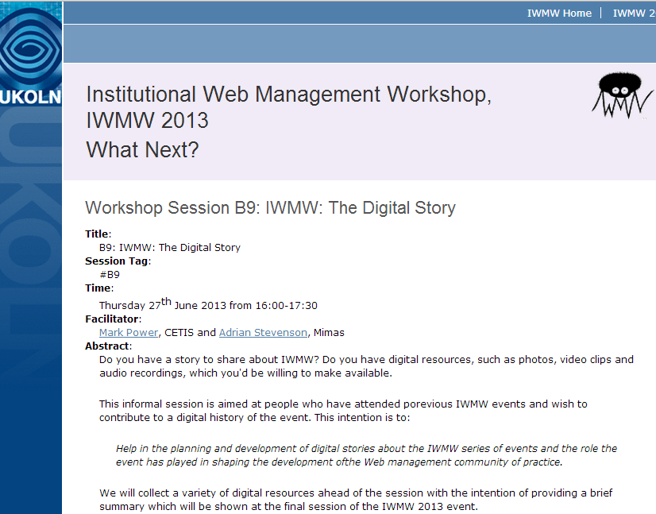
Digital story session

Slide 9
IWMW is … A shared service which enables the UK higher education sector to benefit from learning from shared experiences
What is IWMW?

Slide 10
Future of IWMW
Some questions I posed:
Is there still a need?
Is there a business model?
Are there opportunities for changes?
Your input:
What did you say in the survey at http://bit.ly/iwmw-future

Slide 11
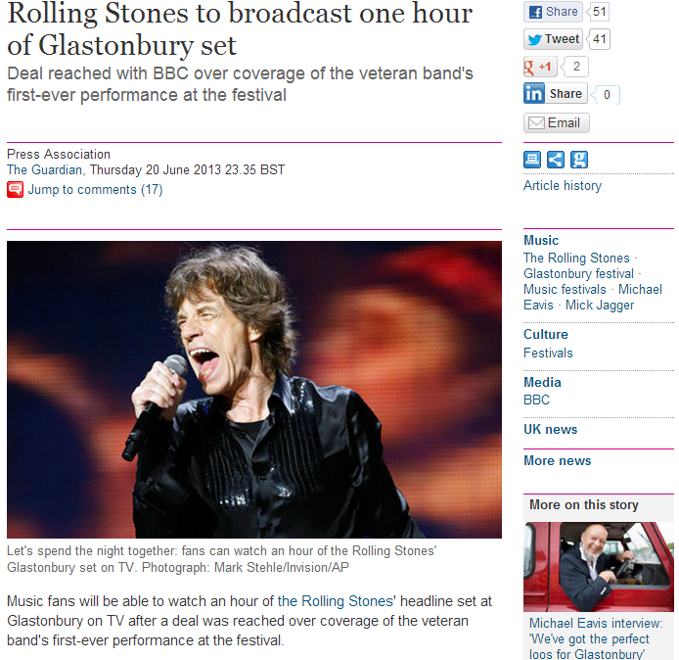
Business Models
Option 1
Inspired by Glastonbury

Slide 12
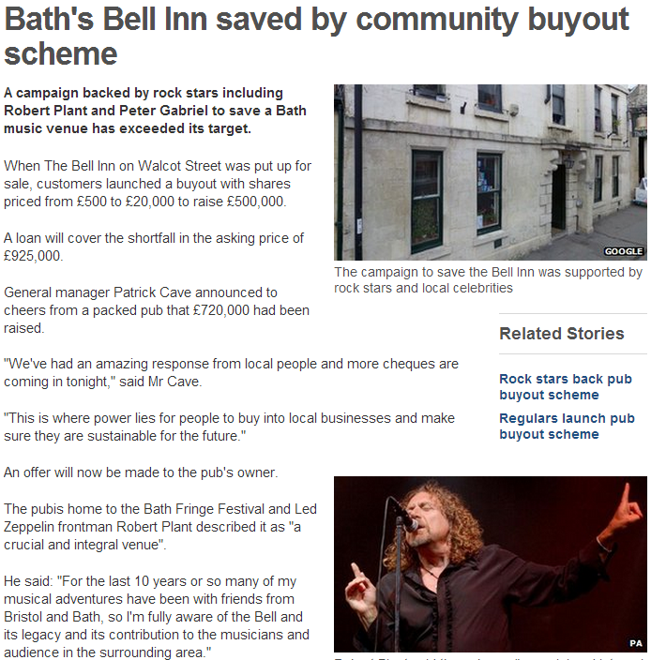
New Business Models
Option 2
BBC News, 21 March 13

Slide 13
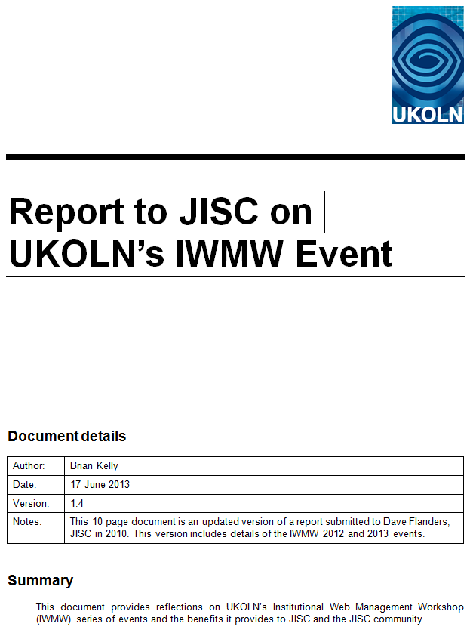
Option 3
Option 3
Develop business proposal:
Replace report on value (to JISC) with business plan
Outline funding models
Explore multiple funders
Seek trusted ‘owner’
Announce decision by 1 Dec

Slide 14
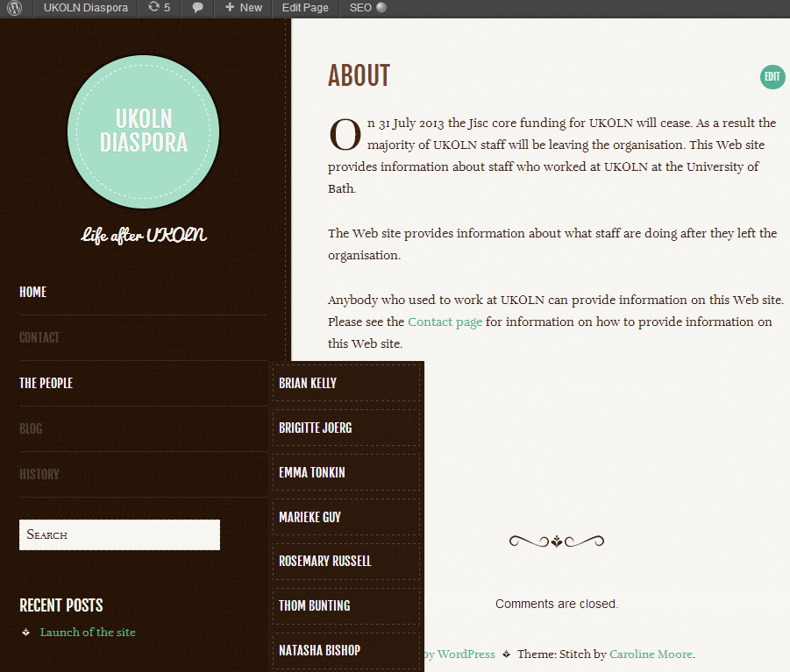
What of UKOLN Staff?
http://ukoln-diaspora.org.uk/
What of UKOLN staff? UKOLN Diaspora site will provide information.

Slide 15
Over to You!
http://www.flickr.com/photos/gauri_lama/3039881498/

