Slide 1
Et tu MOOC? Massive Online Considerations
Kyriaki Anagnostopoulou
Head of e-Learning, University of Bath
26th June 2013

Slide 2
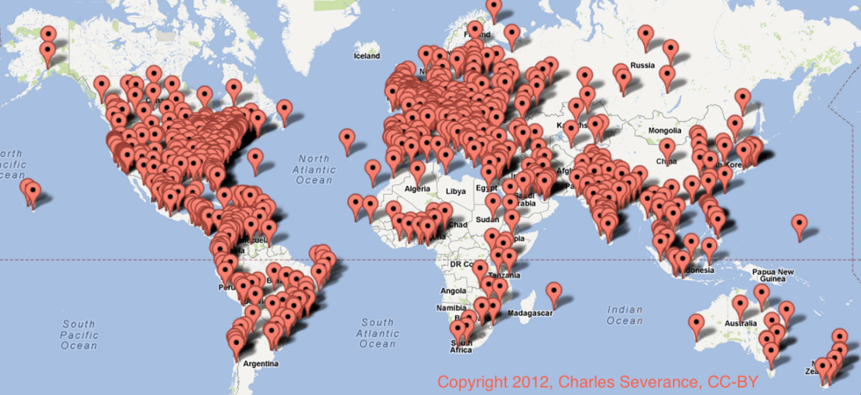
Massive Open Online Courses
Thousands of participants
Global reach
Open access to education of the highest quality
Free at the point of delivery to ‘students’
Education for all – strong moral argument from top HEIs
New platforms developed
Sophisticated analytics defining new pedagogies
Highly participatory
Facilitated courses
Internet History, Technology, and Security course
University of Michigan on Coursera
Defined beginning and end
No formal entry requirements
Do not typically offer a qualification
Do not typically offer credits at any other HEI than the one that offered the MOOC

Slide 3
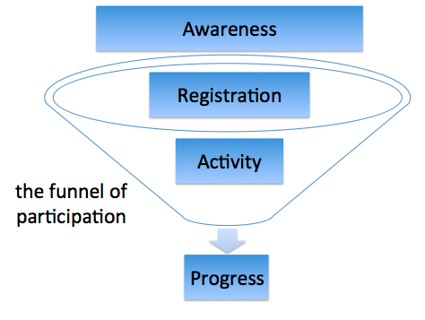
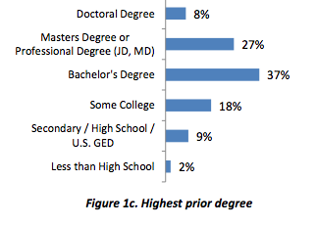
Massive Open Online Courses
Approx. 90-95% drop out rate
Participants tend to be highly educated, already have a degree, take part as a CPD activity to develop competencies
Business models emerging
Thousands of students
Global reach
Open access to education of the highest quality
Free at the point of delivery to ‘students’
Education for all – strong moral argument from top HEIs
New platforms developed
Sophisticated analytics defining new pedagogies
Highly participatory
Facilitated courses
Clow, Doug (2013). MOOCs and the funnel of participation. In: Third Conference on Learning Analytics and Knowledge (LAK 2013), 8-12 April 2013, Leuven, Belgium, p185-189. New York: ACM.
Data not ‘open’ – commercial sensitivities
Pedagogically stale?
Limitations of online facilitation
Defined beginning and end
No formal entry requirements
Do not typically offer a qualification
Do not typically offer credits at any other HEI than the one that offered the MOOC
Screen shot from Duke University report on development of Bioelectricity: A Quantitative Approach offered through Coursera in June 2012
Accreditation models emerging
Brand = quality
Digital literacies and study skills

Slide 4
Year of the MOOC
Students flock to MOOCs to complement studies – University World News
Are MOOCs a game changer for higher education? - OBHE
Embrace MOOCs or face decline, warns VC – THES
Moody’s say MOOCs could raise a university’s credit rating – Chronicle of Higher Education

Slide 5
Massive Open Online Courses
Internationalisation
Widening Participation
Marketing
Public Engagement
Learning & Teaching
E-Learning
Web Services
ICT
Recruitment & Admissions
Quality Codes of Practice
Regulations

Slide 6
Academic
Technical
Administrative

Slide 7
Why HEIs offer MOOCs
Democratisation
Reputation/Brand extension
Innovation
Risk of lagging behind
Experimentation/research
230+ courses from 40+ providers, in various languages
Massive media hype
Changing dynamics of HE
Pan-European MOOC provider – OpenUpEd

Slide 8
Why students enrol on MOOCs
Stanford, 2012
http://etcjournal.com/2013/04/23/time-out-at-tcc-2013-how-social-media-saved-the-day/

Slide 9
Edinburgh on Coursera – case study
Artificial Intelligence Planning
Critical Thinking in Global Challenges
E-learning and Digital Cultures
Equine Nutrition
Introduction to Philosophy
Astrobiology and the Search for Extra-terrestrial Life
100,000 students in first week
From 300+ countries
Format:
5-7 weeks
weekly plan
Videos, quizzes, discussion board
Facilitation

Slide 10
Business models?
Wide variation in estimates
Mainly funded as marketing or WP initiatives
Fee for certificate of completion, assessment, charging for premium services
Charging employers for hiring access to the best students (Coursera & Udacity)
Licensing fees for educational institutions that use Coursera materials.
Alternative funding models being sought (mainly UK):
Sponsorship from industry partners
Working with professional bodies which require continuous professional development (i.e. pharmacists, teachers, etc)
Producing a MOOC on the back of an externally funded project (ESRC, etc)

Slide 11
OU’s spin-off commercial company
UK response to US MOOCs
New platform
Distinctive features/differentiation from US MOOCs
League stars – 21 HEIs plus British institutions
HEIs responsible for content, quality, any accreditation and cost of courses offered online.

Slide 12
FutureLearn Partners
University of Bath
University of Birmingham
University of Bristol
Cardiff University
University of East Anglia (UEA)
The University of Edinburgh
University of Exeter
University of Glasgow
King’s College London
Lancaster University
University of Leeds
University of Leicester
Loughborough University
Monash University
The University of Nottingham
The Open University
Queen’s University, Belfast
University of Reading
The University of Sheffield
University of Southampton
University of Strathclyde
Trinity College Dublin
The University of Warwick
British Council
British Library
British Museum

Slide 13
Looking at Bath….

Slide 14
Pause for thought - 1
Should we be considered integrating a MOOC from another university into our own teaching? Should we direct your students to a MOOC for additional support? Is a MOOC the new text book?

Slide 15
Pause for thought - 2
Are we prepared to be judged based on the online learning experiences that we offer? What kind of MOOCs should the University of Bath be offering? What should we be avoiding?

Slide 16
Pause for thought - 3
As a tutor/facilitator, how do you deal with a 1:8000 staff-student ratio? How would you make your presence felt in the massive global classroom? How would you make students feel supported?

Slide 17
Pause for thought - 4
In their application a prospective student has noted that they have successfully completed one of our MOOCs. Although our MOOCs are not credit bearing, would you see this as an advantage? What if the MOOC was from another reputable university?

Slide 18
Pause for thought - 5
Our traditional campus-based students are already accessing high quality MOOC learning materials for free from elite universities globally. Do you think this will result in higher expectations of e-learning provision within our face-to-face courses?

Slide 19
Who?
Planning and approval process
Production
Project manager
Subject experts
Academic staff (internal or external) - authors
Subject librarians – advise and source available digital content
Learning Technologists/instructional designers
IP & Legal Services, CPD, WPO
Technical Content producers
Academic staff
Learning technologist
AV staff
Marketing/Web services
Proof reader/copy editor
‘Go live’ & facilitation (Autumn 2013)
Subject expert
Learning technologist
Programme administrator
Marketing
Of the MOOCs
Of the University on
FutureLearn website
FutureLearn learning platform
Within the MOOCs we offer
Other aspects?
In the process of:
Agreement from academic staff
Operational project team
Project plan

Slide 20
Challenges/opportunities
Immediate
Medium term
Truly cross-institutional
Prioritisation
Timescales
Unknown territory
Learning, planning and doing at the same time
Designing effective MOOCs – large scale ‘learning design’
Quality = Brand
Accreditation and APEL
Rich resources and new technologies for free to all, but what about our campus based students?
Learning Analytics – new research area?
Sustainability

Slide 21
Questions and Discussion
K.Anagnostopoulou@bath.ac.uk

