Slide 1
Welcome to the Institutional Web Management Workshop 2013 “What Next?”
Twitter:
#iwmw13
#P0
http://iwmw.ukoln.ac.uk/iwmw2013/talks/welcome/
Brian Kelly
UKOLN
University of Bath
Bath, UK
Acceptable Use Policy
Recording this talk, taking photos, discussing the content using Twitter, blogs, etc. is permitted providing distractions to others is minimised.
Email:
b.kelly@ukoln.ac.uk / ukwebfocus@gmail.com
Blog:
http://ukwebfocus.wordpress.com/
Twitter:
http://twitter.com/briankelly/
UKOLN ISC is supported by:
This work is licensed under a Creative Commons Attribution- 2.0 licence (but note caveat)

Slide 2
Official Opening
IWMW 2013 will be opened by the Mayor of Bath

Slide 3
This year’s theme ….

Slide 4
This year’s theme ….
What Next?

Slide 5
What Next? (Wed-Friday)
Wednesday 26 June
11.00-12.30 Opportunities & Openness
14.00-15.30 Supporting Key Institutional Drivers
16.00-17.30 Parallel sessions
19.00- Conference meal (Claverton rooms)
Thursday 29 June
09.00-10.30 The User Experience
11.00-12.30 The Changing Technical Landscape
14.00-15.30 The View From Outside
16.00-17.30 Parallel sessions
19.00- Reception & DIY meal / drinks

Slide 6
What Next? (Wed-Friday)
Friday 28 June
09.30-11.00 Institutional Case Studies
11.30-13.00 What Does The Future Hold?
Parallel Sessions
Attend two of the 20 available
WiFi
Use Eduroam or ask for username & password
Event Amplification
Join in on #iwmw13 & share your thoughts

Slide 7
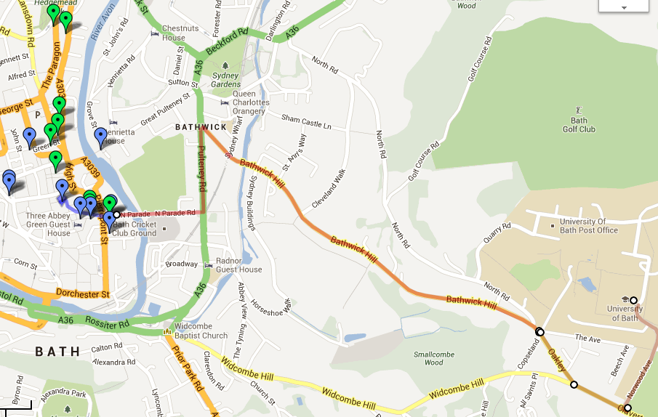
Map of Bath
http://bit.ly/iwmw13map
Map of Bath
Wed: Meal on campus
Thur: Roman Baths & DIY dinner

Slide 8
What Next (after Friday!)
The continued financial challenges:
£9,000 fees / Redundancies in the sector
The changing technical environment:
Growth in use of Cloud services, mobile access, social media, open data, …
Are Web technologies now an off-the-shelf commodity?
The specifics:
Jisc decision to cease support for IWMW
Jisc’s core funding of UKOLN to cease
Large-scale redundancies at UKOLN

Slide 9
IWMW History
Early Years
1997 | 1998 | 1999
Launch at KCL
IWMW brand
“Who will rid me of this troublesome beast?”
Professor John Slater, PVC Learning & Teaching at University of Kent

Slide 10
IWMW History
Growth of the community
2000 | 2001 | 2002
“A Controversial Proposal”
First live video-streaming of plenary talks
Derek Law, University Librarian & Director of Information Strategy at University of Strathclyde on:
“Avoiding turf wars, hiding real ownership costs, not scaring the management and letting everyone else think it was their idea”
175 participants
18-20 June, finished day before England vs Brazil

Slide 11
IWMW History
The Web Management Years
2003 | 2004 | 2005
Professor Melville, VC, University of Kent on “exciting opportunities”
Transforming the Organisation: talks on Web strategies, e-business, intranets, ….
CMS: our shared challenges
There Is No Silver Bullet
The CMS Panel
WiFi / London Bombing

Slide 12
IWMW History
The Web 2.0 Years
2006 | 2007 | 2008
Developing a Web 2.0 Strategy
What Does Openness Mean to the Web Manager?
Let the Students do the Talking...
Can Your Web Site Be Your API?
Science in the YouTube Age
Unleashing the Tribe
150+ people watched live video stream

Slide 13
IWMW History
The Economic Cloud
2009 | 2010 | 2011
Launch of iwmw.ukoln.ac.uk
Headlights on Dark Roads
“The Web In Turbulent Times”:
‘So what do you do exactly?’ In challenging times justifying the roles of the web teams
No money? No matter - Improve your website with next to no cash
“Responding to Change”:
Marketing and Other Dirty Words
Using activity data to support your users
Embedding Web 2.0

Slide 14
Yesterday, Today & Tomorrow
The Economic Cloud continues
2012 | 2013 | 2014
“Embedding Innovation”
Open data
Move towards diversification
“What Next?”
Future for Web management?
Future for community?
Future of IWMW?

Slide 15
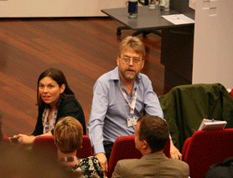
Who Provides IWMW?
IWMW 1997-2013:
Provided by UKOLN
Chaired by Brian Kelly (all) and Marieke Guy (2006-11)
Funded by Jisc, participants and sponsors
Content provided by practitioners & invited guest speakers

Slide 16
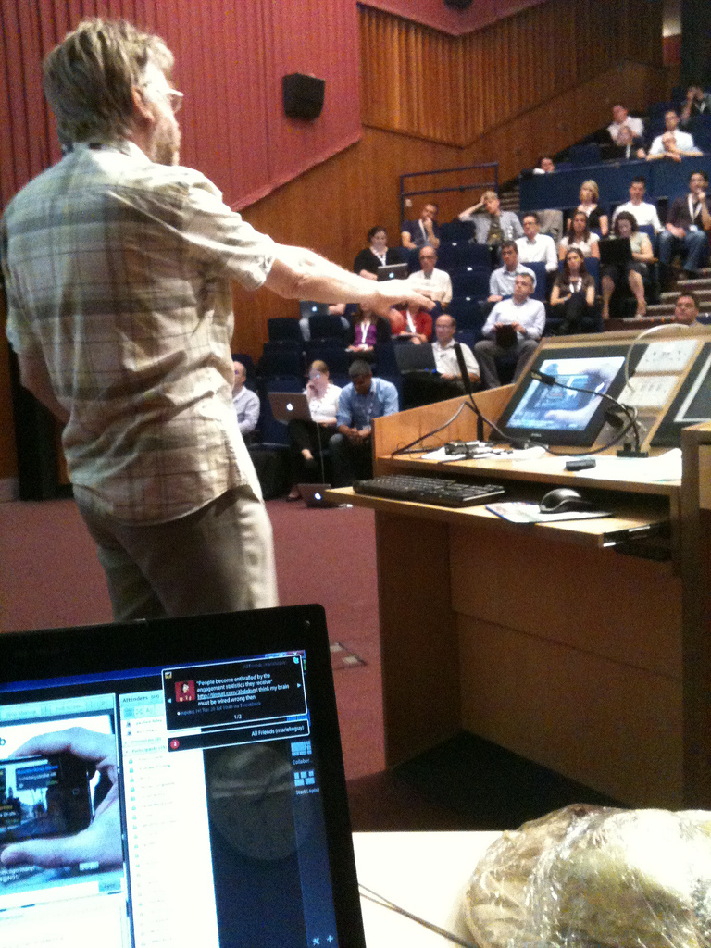
Participation From Outside
Event amplification:
Exploiting:
WiFi networks
Mobile devices
To facilitate:
Discussions
Exchange of ideas for participants
Sustainable community-building

Slide 17
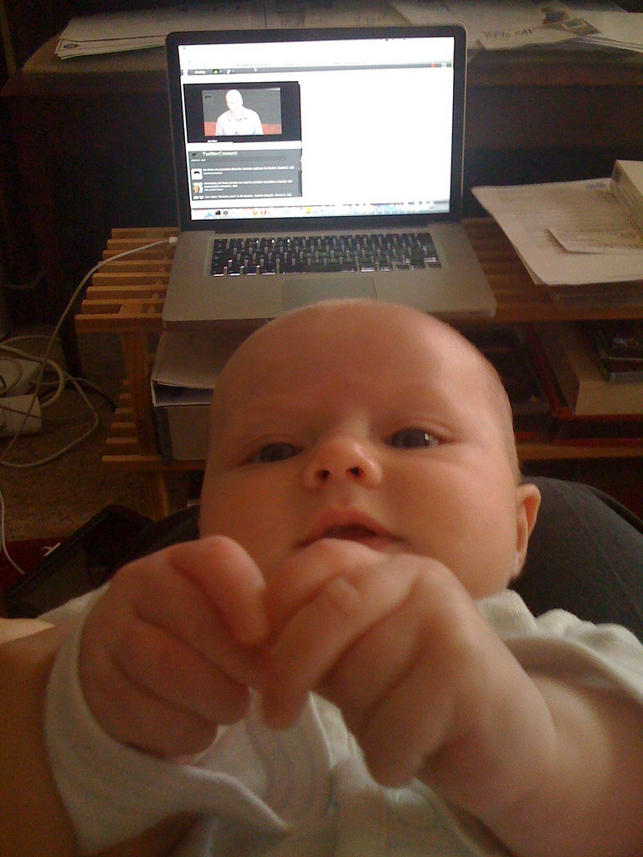
Janet McKnight (@J4) keeping up-to-date at #IWMW11 while on maternity leave

Slide 18
IWMW is … A shared service which enables the UK higher education sector to benefit from learning from shared experiences
What is IWMW?

Slide 19
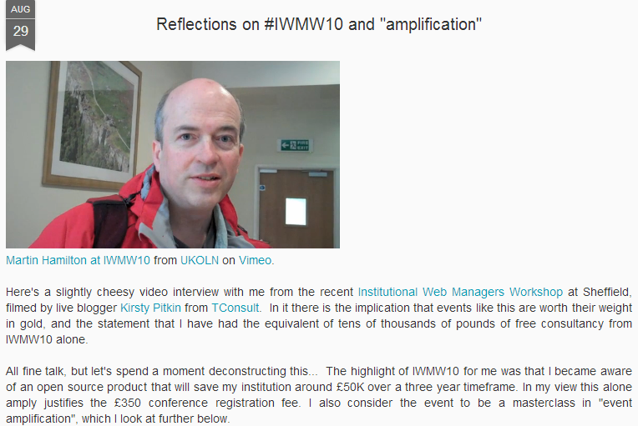
Opportunities & Benefits
Martin Hamilton

Slide 20
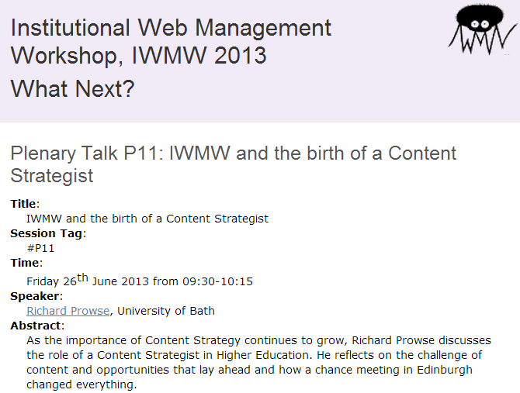
Opportunities & Benefits
Richard Prowse:
As the importance of Content Strategy continues to grow, Richard Prowse discusses the role of a Content Strategist in Higher Education. He reflects on the challenge of content and opportunities that lay ahead and how a chance meeting in Edinburgh changed everything.

Slide 21
Future of IWMW
Some questions?
Is there still a need?
Is there a business model?
Are there opportunities for changes?
Your input:
Please complete the survey: http://bit.ly/iwmw-future (local & remote participants)
Ideas welcome on:
Your interest in future events
The format and structure
Improvements
Business models for sustainability
Or chat to me / email me

Slide 22
Over to You!
http://www.flickr.com/photos/gauri_lama/3039881498/

Slide 23
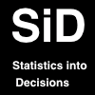
Thanks to Our Sponsors
TerminalFour
Siteimprove
Headscape
Statistics into Decisions
Sword
Squiz
Sponsoring consultants

Slide 24
Let IWMW 2013 Begin!
http://www.flickr.com/photos/ssteeples/2697555399/

